Slide 1
SC1015-Intro to Data Sci & Art Intell

Slide 2
Our Topic: World Happiness
Are you happy bro?

Slide 3
Why World Happiness?
World happiness is closely linked to various positive outcomes, such as better health, higher levels of productivity, and stronger social connections
An indicator of how well people are doing in different countries around the world
The levels and determinants of world happiness are closely tied to:
economic development
social equality
political stability
environmental sustainability

Slide 4
Dataset Used:
World Happiness Report 2022
https://www.kaggle.com/datasets/ajaypalsinghlo/world-happiness-report-2022

Slide 5
Table of contents
01
02
Exploratory Data Analysis
Data Cleaning
03
04
Random Forest
Hierarchical Clustering

Slide 6
01
Exploratory Data Analysis

Slide 7
EDA
a statistical approach used to analyze and summarize datasets to gain insights into their characteristics and uncover patterns and relationships among the variables

Slide 10
02
Data Cleaning

Slide 13
03
Random Forest

Slide 16
04
Hierarchical Clustering

Slide 19
Conclusion

Slide 20
Outcome of Project

Slide 21
Insights Obtained

Slide 22
Thanks!

Slide 23
Thanks!

Slide 24
Communication skills
Mother tongue(s)
English
Spanish
Other languages(s)
 | Written | Spoken | Certificate
Germany |  |  | B2
French |  |  | C1
Russian |  |  | A2

Slide 25
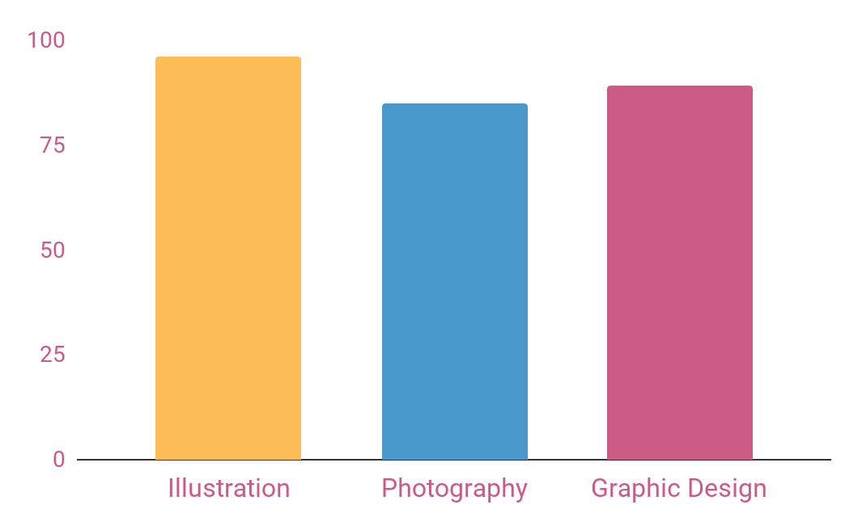
Skills
Illustration
It’s beautiful name
Photography
Mars is a cold place
96%
85%
89%
Graphic Design
It’s the biggest planet
Follow the link in the graph to modify its data and then paste the new one here. For more info, click here

Slide 26
Technical skills
Illustration
Graphic Design
Reading
Draw
Mercury is the closest planet to the Sun
Despite being red, Mars is a cold place
Venus has a beautiful name, but it’s hot
Jupiter is the biggest planet of them all

Slide 27
Experience
Mercury
Venus
Mercury is the closest planet to the Sun
Venus has a beautiful name, but it’s hot
2010
2015
2018
2020
Mars
Jupiter
Despite being red, Mars is a cold place
Jupiter is the biggest planet of them all

Slide 28
My expertise
Skills | Year | Skill level
Graphic Design | 2018/2019
Computer and internet | 2017/2020
Advanced Photography | 2020/2021

Slide 29
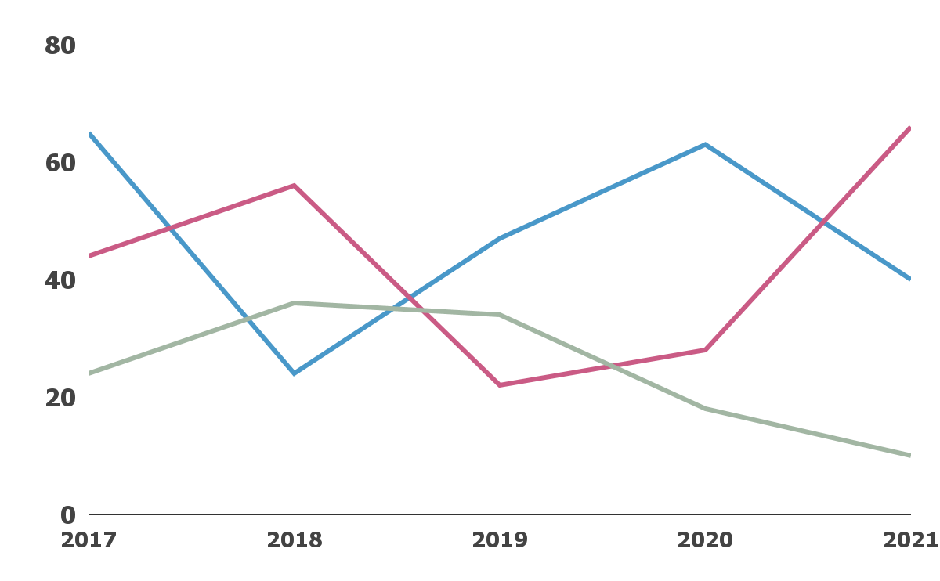
Graph about my volunteer work
Venus
It’s the second planet from the Sun
Mars
Despite being red, Mars is a cold place
Jupiter
It’s a gas giant and the biggest planet
Follow the link in the graph to modify its data and then paste the new one here. For more info, click here

Slide 30

A picture is worth a thousand words

Slide 31
Volunteer work
Venus
Mercury
Mars
Jupiter
Saturn
Neptune
Venus is the second planet from the Sun
It’s the closest planet to the Sun
Despite being red, Mars is a cold place
It’s the biggest planet of them all
It’s composed of hydrogen and helium
It’s the farthest planet from the Sun

Slide 32
Computer skills
75%
95%
90%
83%
Ps
Ai
Jupiter is the biggest planet of them all
Saturn is the ringed one and a gas giant
Id
Lr
Neptune is the farthest planet from the Sun
Earth is the planet where all we live on

Slide 33
Conclusion
Music
Reading
Travel
Mercury is the closest planet to the Sun
Venus has a beautiful name, but it’s hot
Despite being red, Mars is a cold place

Slide 34
Contact
Address
Phone
Email
Cell Phone
Your address here
001 664 123 4567
example@freepik.com
123 456 123 1231

Slide 35

Visit my website
You can replace the image on the screen with your own work. Just delete this one, add yours and center it properly

Slide 36
Alternative resources

Slide 37
Resources
Did you like the resources on this template? Get them for free at our other websites:
Vectors
Hand drawn shooting star background
Cute stars colección
Flat emoticon reaction collection
Photos
Portrait of happy woman laughing with copy space and mouth
Low angle woman dj in club entertaining crowd

Slide 38
Instructions for use
In order to use this template, you must credit Slidesgo by keeping the Thanks slide.
You are allowed to:
- Modify this template.
- Use it for both personal and commercial projects.
You are not allowed to:
- Sublicense, sell or rent any of Slidesgo Content (or a modified version of Slidesgo Content).
- Distribute Slidesgo Content unless it has been expressly authorized by Slidesgo.
- Include Slidesgo Content in an online or offline database or file.
- Offer Slidesgo templates (or modified versions of Slidesgo templates) for download.
- Acquire the copyright of Slidesgo Content.
For more information about editing slides, please read our FAQs or visit Slidesgo School:
https://slidesgo.com/faqs and https://slidesgo.com/slidesgo-school

Slide 39
Fonts & colors used
This presentation has been made using the following fonts:
Russo One
(https://fonts.google.com/specimen/Russo+One)
Fira Sans
(https://fonts.google.com/specimen/Fira+Sans)
#eee3df
#ffbd58
#ca5b85
#a2b6a3
#4998c9
#434343

Slide 40





Storyset
Create your Story with our illustrated concepts. Choose the style you like the most, edit its colors, pick the background and layers you want to show and bring them to life with the animator panel! It will boost your presentation. Check out How it Works.
Pana
Amico
Bro
Rafiki
Cuate

Slide 41
Use our editable graphic resources...
You can easily resize these resources without losing quality. To change the color, just ungroup the resource and click on the object you want to change. Then, click on the paint bucket and select the color you want. Group the resource again when you’re done. You can also look for more infographics on Slidesgo.

Slide 44
JANUARY
FEBRUARY
MARCH
APRIL
MAY
JUNE
PHASE 1
Task 1
Task 2
PHASE 2
Task 1
Task 2
JANUARY
FEBRUARY
MARCH
APRIL
PHASE 1
Task 1
Task 2

Slide 47


